Slide 1
MN-201: Mining project
Exploratory Project: Naïve Bayes Classifier
Name: Shubham Samrat
Roll No:19155092
Serial No: AE-112
19155092

Slide 2
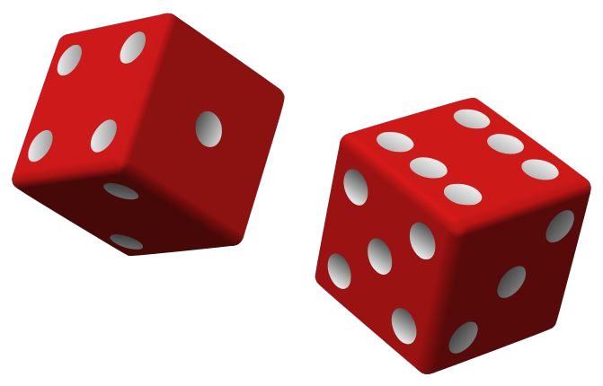
Naive Bayes classifier
19155092

Slide 3
Naive Bayes - Introduction
Naive Bayes - (Sometime aka Stupid Bayes :) )
Classification technique based on Bayes’ Theorem
With “naive” assumption of independence among predictors.
Easy to build
Particularly useful for very large data sets
Known to outperform even highly sophisticated classification methods
e.g. Earlier method for spam detection
19155092

Slide 4
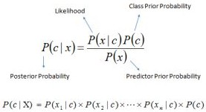
Introduction - Bayes theorem
P(c|x) - the posterior probability of class (c, target) given predictor (x, attributes).
P(c) - the prior probability of class.
P(x|c) - is the likelihood which is the probability of predictor given class.
P(x) - is the prior probability of predictor.
19155092

Slide 5
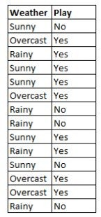
How Naive Bayes algorithm works
We are training data set of weather and corresponding target variable ‘Play’ (suggesting possibilities of playing).
Now, we need to classify whether players will play or not based on weather condition.
19155092

Slide 6
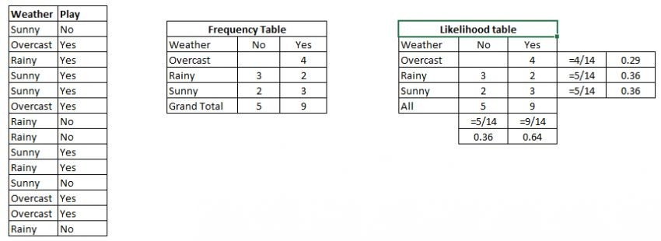
How Naive Bayes algorithm works
Convert the data set into a frequency table
Create Likelihood table by finding the probabilities like Overcast probability = 0.29 and probability of playing is 0.64.
Now, use Naive Bayesian equation to calculate the posterior probability for each class. The class with the highest posterior probability is the outcome of prediction.
19155092

Slide 7
How Naive Bayes algorithm works
Problem: Players will play if weather is sunny. Is this statement is correct?
19155092

Slide 8
How Naive Bayes algorithm works
Problem: Players will play if weather is sunny. Is this statement is correct?
P(Yes | Sunny) = P( Sunny | Yes) * P(Yes) / P (Sunny)
19155092

Slide 9
How Naive Bayes algorithm works
Problem: Players will play if weather is sunny. Is this statement is correct?
P(Yes | Sunny) = P( Sunny | Yes) * P(Yes) / P (Sunny)
Here we have
P (Sunny |Yes) = 3/9 = 0.33,
P(Sunny) = 5/14 = 0.36,
P( Yes)= 9/14 = 0.64
19155092

Slide 10
How Naive Bayes algorithm works
Problem: Players will play if weather is sunny. Is this statement is correct?
P(Yes | Sunny) = P( Sunny | Yes) * P(Yes) / P (Sunny)
Here we have
P (Sunny |Yes) = 3/9 = 0.33,
P(Sunny) = 5/14 = 0.36,
P( Yes)= 9/14 = 0.64
Now, P (Yes | Sunny) = 0.33 * 0.64 / 0.36 = 0.60, (high probability)
19155092

Slide 11
How Naive Bayes algorithm works
Problem: Players will play if weather is sunny. Is this statement is correct?
P(No | Sunny) = P( Sunny | No) * P(No) / P (Sunny)
Here we have
P (Sunny |No) = 2/5 = 0.4,
P(Sunny) = 5/14 = 0.36,
P( No)= 5/14 = 0.36
Now, P (No | Sunny) = 0.4 * 0.36 / 0.36 = 0.40, (low probability)
19155092

Slide 12
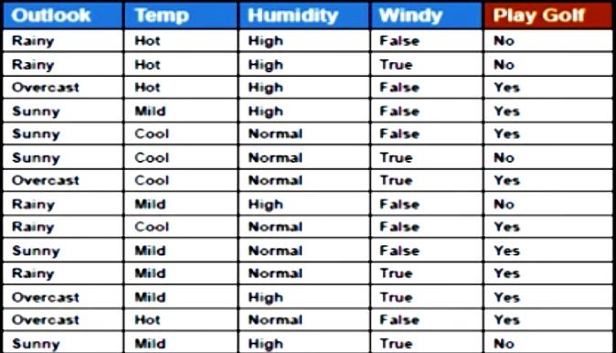
How Naive Bayes algorithm works
For Outlook = Rainy, Temp = Mild, Humidity = Normal, Windy = True, YES or No?
Problem2: Rainy Mild Normal True ???
19155092

Slide 13
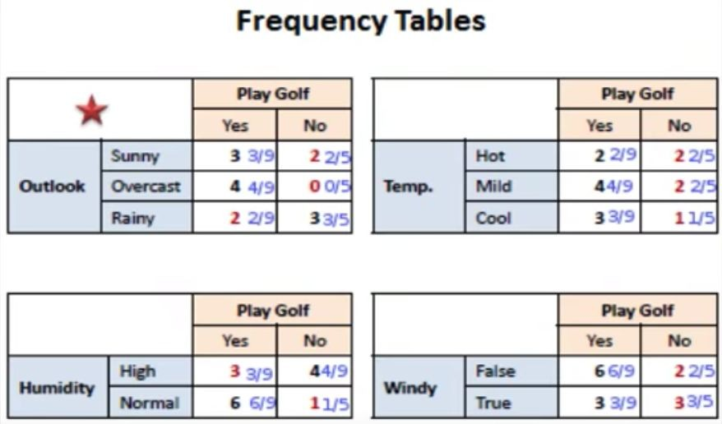
How Naive Bayes algorithm works
Lets prepare frequency tables of each feature
19155092

Slide 14
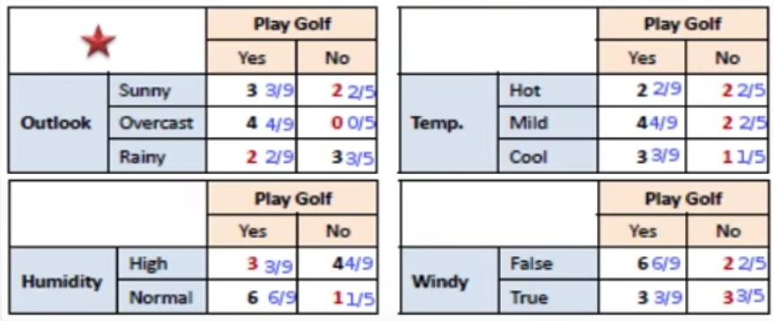
How Naive Bayes algorithm works
Problem2: For Outlook = Rainy, Temp = Mild, Humidity = Normal, Windy = True, YES or No?
19155092

Slide 15
How Naive Bayes algorithm works
Problem2: For Outlook = Rainy, Temp = Mild, Humidity = Normal, Windy = True, YES or No?
Likelihood of yes = P(Outlook = Rainy|Yes) * P(Temp = Mild| Yes) * P(Humidity = Normal|Yes)*P(Windy = True|Yes)*P(Yes) = ?
19155092

Slide 16
How Naive Bayes algorithm works
Problem2: For Outlook = Rainy, Temp = Mild, Humidity = Normal, Windy = True, YES or No?
Likelihood of yes = P(Outlook = Rainy|Yes) * P(Temp = Mild| Yes) * P(Humidity = Normal|Yes)*P(Windy = True|Yes)*P(Yes)
= 2/9 * 4/9 * 6/9 * 3/9 * 9/14
= 0.0141
19155092

Slide 17
How Naive Bayes algorithm works
Problem2: For Outlook = Rainy, Temp = Mild, Humidity = Normal, Windy = True, YES or No?
Likelihood of yes = P(Outlook = Rainy|Yes) * P(Temp = Mild| Yes) * P(Humidity = Normal|Yes)*P(Windy = True|Yes)*P(Yes)
= 2/9 * 4/9 * 6/9 * 3/9 * 9/14
= 0.0141
Likelihood of No = P(Outlook = Rainy|No) * P(Temp = Mild| No) * P(Humidity = Normal|No)*P(Windy = True|No)*P(No)
= 3/5 * 2/5 * 1/5 * 3/5 * 5/14
= 0.0103
19155092

Slide 18
How Naive Bayes algorithm works
Problem2: For Outlook = Rainy, Temp = Mild, Humidity = Normal, Windy = True, YES or No?
Likelihood of yes = 0.0141
Likelihood of No = 0.0103
After Normalization,
Yes = 0.0141 / (0.0141 + 0.0103) = 0.58
No = 0.0103 / (0.0141 + 0.0103) = 0.42
19155092

Slide 19
How Naive Bayes algorithm works
Problem2: For Outlook = Rainy, Temp = Mild, Humidity = Normal, Windy = True, YES or No?
YES
19155092

Slide 20
Zero Frequency Problem
What if any of the count is 0?
19155092

Slide 21
Zero Frequency Problem
What if any of the count is 0?
Add 1 to all counts
It is a form of Laplace smoothing
See https://en.wikipedia.org/wiki/Additive_smoothing
19155092

Slide 22
Using python
#Import Library of Gaussian Naive Bayes model
from sklearn.naive_bayes import GaussianNB
import numpy as np
#assigning predictor and target variables
X= np.array([[-3,7],[1,5], [1,2], [-2,0], [2,3], [-4,0], [-1,1], [1,1], [-2,2], [2,7], [-4,1], [-2,7]])
y = np.array([3, 3, 3, 3, 4, 3, 3, 4, 3, 4, 4, 4])
#Create a Gaussian Classifier
model = GaussianNB()
# Train the model using the training sets
model.fit(X, y)
#Predict Output
predicted= model.predict([[1,2],[3,4]])
print(predicted)
See the Jupyter Notebook.
19155092

Slide 23
Tips to improve the Naive Bayes Model
If continuous features do not have normal distribution,
○ we should use transformation or different methods to convert
● If test data set has zero frequency issue,
○ apply smoothing techniques “Laplace smoothing”
● Remove correlated features,
○ as the highly correlated features are voted twice in the model
○ and it can lead to over inflating importance.
● Naive Bayes classifier has limited options for parameter tuning
● Can’t be ensembled - because there is no variance to reduce
19155092

Slide 24
Variants
Gaussian:
It is used in classification and it assumes that features follow a normal distribution.
Multinomial:
It is used for discrete counts.
Implements the naive Bayes algorithm for multinomially distributed data
It is one of the two classic naive Bayes variants used in text classification
Bernoulli:
The binomial model is useful if your feature vectors are binary (i.e. zeros and ones).
One application would be text classification with ‘bag of words’ model
where the 1s & 0s are “word occurs in the document”
and “word does not occur in the document” respectively.
http://scikit-learn.org/stable/modules/naive_bayes.html
19155092

Slide 25
Applications
1. Real time Prediction:
○ Naive Bayes is an eager learning classifier and it is sure fast.
Thus, it could be used for making predictions in real time.
2. Multi class Prediction:
○ Well known for multi class prediction feature.
19155092

Slide 26
Applications
1. Text classification/ Spam Filtering/ Sentiment Analysis:
○ Mostly used in text classification
○ Have higher success rate as compared to other algorithms.
○ Widely used in Spam filtering (identify spam e-mail)
○ and Sentiment Analysis
2. Recommendation System:
○ Naive Bayes Classifier and Collaborative Filtering together
builds a Recommendation System that uses machine learning
and data mining techniques to filter unseen information and
predict whether a user would like a given resource or not
19155092

Slide 27
Further references
● http://scikit-learn.org/stable/modules/naive_bayes.html
● https://en.wikipedia.org/wiki/Bayes%27_theorem
● https://en.wikipedia.org/wiki/Naive_Bayes_classifier
19155092

Slide 28
Thanks
19155092

